Slide 1
“Schools are not buildings, curriculum timetables and meetings. Schools are relationships and interactions among people.”
Johnson & Johnson, 1994

Slide 2
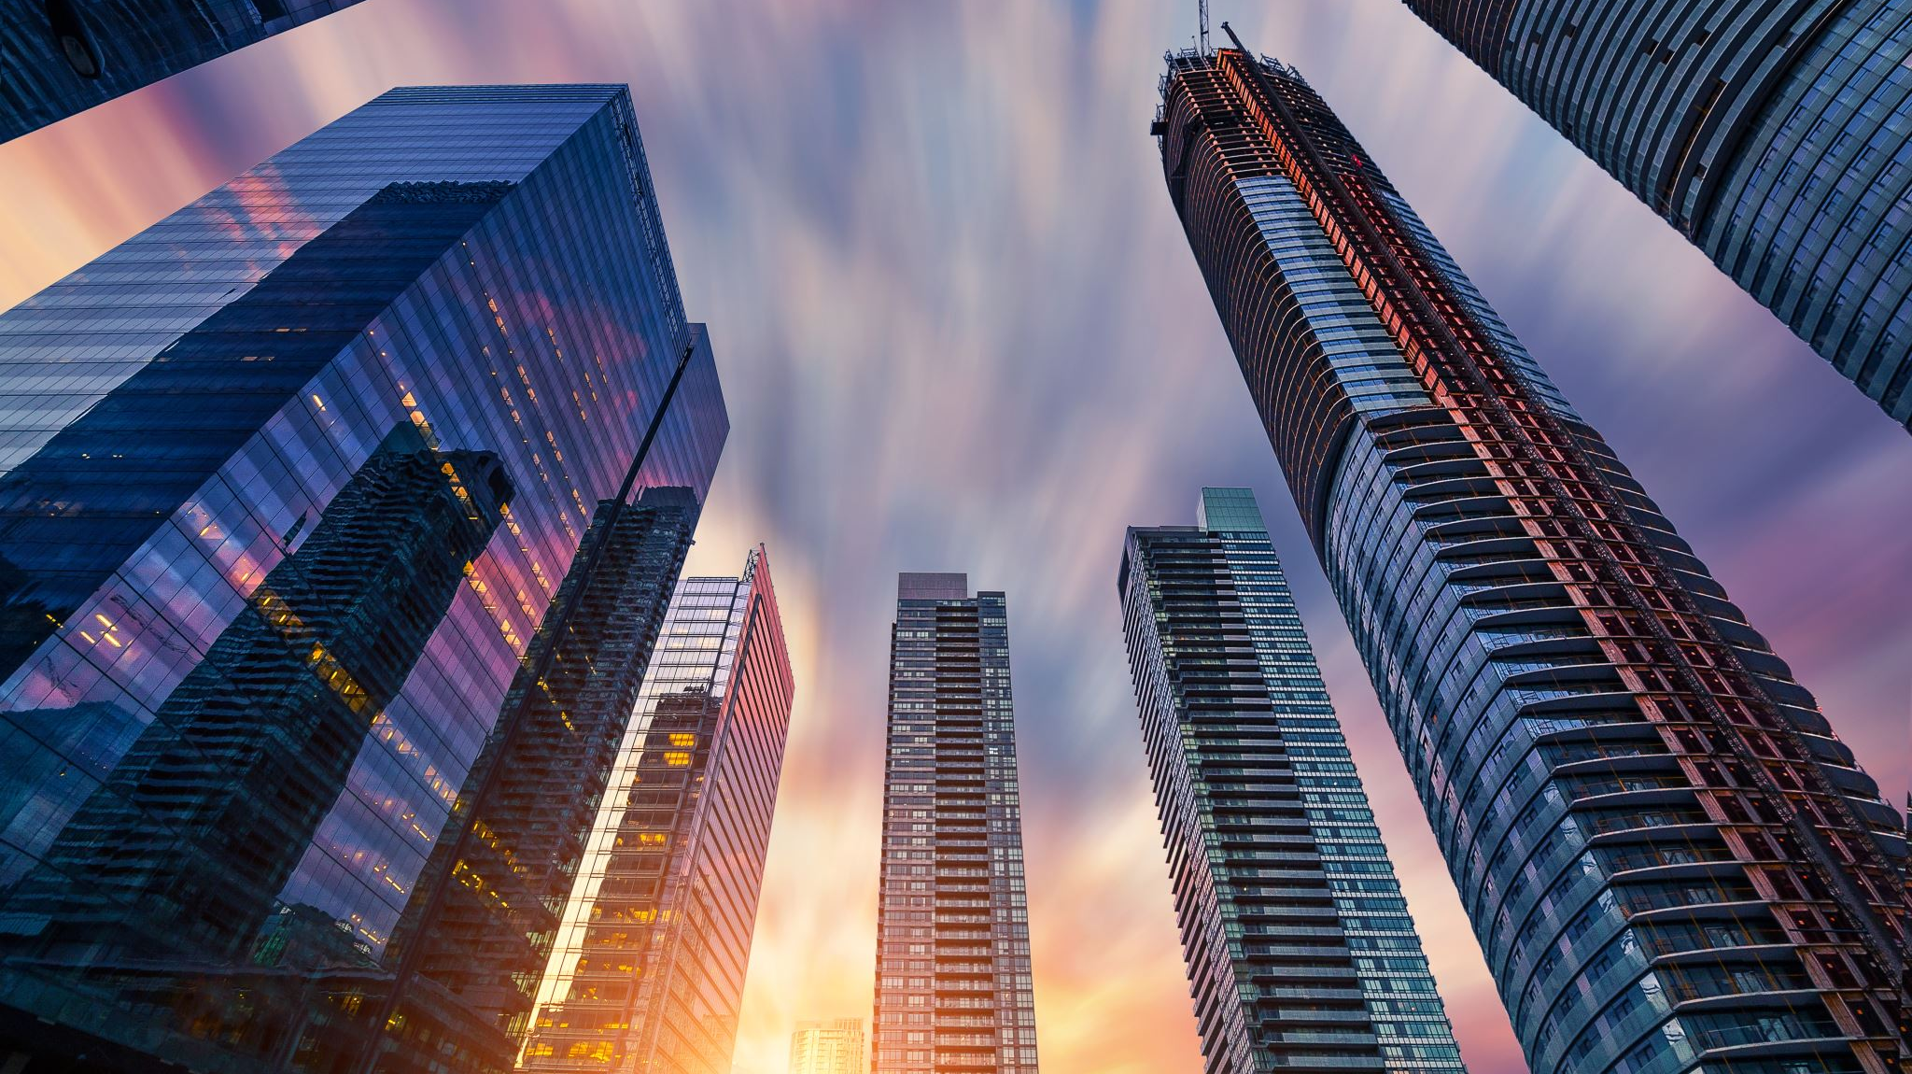
What are Community Building Circles?

Slide 3
We feel connected to other people when we sense that they see us, know us, and care about us.
Community Building Circles occur during Bulldog Block to build & enhance relationships via knowledge and understanding of ourselves and others.
Community Building Circles are one component of Restorative Practices.
The key elements of circles are:
Having positive relationships with classmates.
Understanding and valuing oneself.
Understanding and valuing others.

Slide 4
Ask your student what they are discussing in their Community Building Circles.

